Slide 1





Missouri Commuter Analysis Based on data from XXXXX
Washington University Data Analytics Boot Camp
Fall 2018

Slide 2
What we wanted to understand
How do Missourians commute?
What differences exist for commuting types across counties in Missouri?
What differences exist for commuting types within metropolitan areas in Missouri?

Slide 3
Hypotheses
H₀ ₌ No differences exist between commuting types in metro versus rural counties across Missouri.
H₁ = Differences exist between commuting types in metro versus rural counties across Missouri, where usage of public transit in metro counties is higher.

Slide 4
Definition of Commuting
Census surveys define Commuting (Journey to Work) as “a worker’s travel from home to work”.
Census surveys ask questions about Commuting such as travel time, means of transportation, time of departure for work, vehicles available, and expenses associated with the commute.
For this analysis we looked only at means of transportation

Slide 5
Statewide Analysis

Slide 6
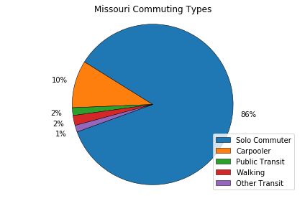
Statewide Analysis

Slide 7
Urban vs. Rural Analysis

Slide 9
Analysis of Missouri’s Metropolitan Statistical Areas (MSA)

Slide 10
MSAs Analyzed
St. Louis
St. Louis City, MO
St. Louis County, MO
St. Charles County, MO
Jefferson County, MO
Franklin County, MO
Lincoln County, MO
Warren County, MO
Madison County, IL
St. Clair County, IL
Clinton County, IL
Monroe County, IL
Jersey County, IL
Kansas City
Bates County, MO
Caldwell County, MO
Cass County, MO
Clay County, MO
Clinton County, MO
Jackson County, MO
Lafayette County, MO
Platte County, MO
Ray County, MO
Johnson County, KS
Leavenworth County, KS
Linn County, KS
Miami County, KS
Wyandotte County, KS
Springfield
Greene County, MO
Christian County, MO
Webster County, MO
Polk County, MO
Dallas County, MO

Slide 11
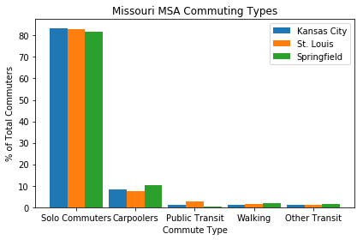
MSA Analysis

Slide 13
Solo Commuters

Slide 14
Carpoolers

Slide 15
Public Transit

Slide 16
Walking

Slide 17

Other Transit

